Slide 1







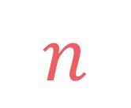

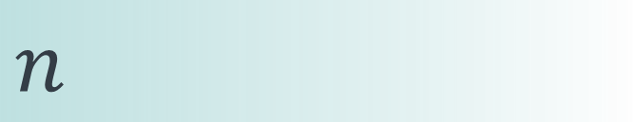

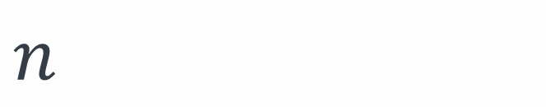
left
[4, 5, 1, 7, 2, 6, 3, 8]
no margin
Space complexity:
$$O(n)$$
list
list
list
list
mid
no margin
"string"
4 | 5 | 1 | 7 | 2 | 6 | 3 | 8
Space complexity:
$$O(n)$$
5
5
$
5
rec(n)
$$n$$
5
$$n$$
$$⇒$$
$$n$$
Time complexity:
$$O(n)$$
text
text
 |  |  | a
$$n$$
text
text
no margin
no margin
no margin
no margin
no margin
no margin
no margin
no margin

Slide 2

Gold mine

Slide 3


Given a $mine$ of n rows and m columns where $mine[i][j]$ represents the amount of gold that is present there, we want to enter from the top of the mine and take as much gold as possible when exiting from the bottom, knowing that we can only move to the bottom, to the bottom-left, or to the bottom-right. We can exit from anywhere from the last row.
$$\left|matrix\right|≥1 \\ \left|matrix\left[i\right]\right|≥1 \\ matrix\left[i\right]\left[j\right]≥0$$

Slide 4

Given a $mine$ of n rows and m columns where $mine[i][j]$ represents the amount of gold that is present there, we want to enter from the top of the mine and take as much gold as possible when exiting from the bottom, knowing that we can only move to the bottom, to the bottom-left, or to the bottom-right. We can exit from anywhere from the last row.
$$\left|matrix\right|≥1 \\ \left|matrix\left[i\right]\right|≥1 \\ matrix\left[i\right]\left[j\right]≥0$$
3
2
12
15
10
input:
mine = [ [3, 2, 12, 15, 10], [6, 19, 7, 11, 17], [8, 5, 12, 32, 21], [3, 20, 2, 9, 7] ]
output: 73
explanation: 15+17+32+9 = 73
6
19
7
11
17
8
5
12
32
21
3
20
2
9
7

Slide 5
rec(i, j)

Slide 6

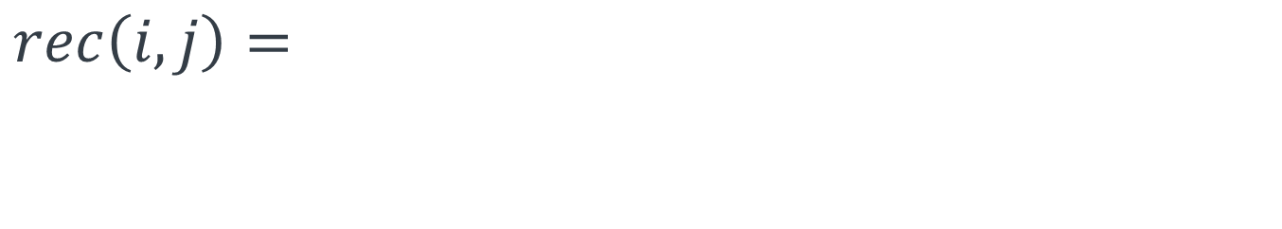
rec(i, j)
by going to the bottom-left
by going to the bottom
by going to the bottom-right
rec(i+1, j-1)
rec(i+1, j)
rec(i+1, j+1)
$$rec\left(i,j\right)=$$
$$rec\left(i,j\right)=mine\left[i\right]\left[j\right]+max⁡(rec\left(i+1,j−1\right), \\ rec\left(i+1,j\right) \\ rec(i+1,j+1)$$

Slide 7
j-1
j
j+1
i
i+1
$$rec\left(i,j\right)=$$
$$rec\left(i,j\right)=mine\left[i\right]\left[j\right]+max⁡(rec\left(i+1,j−1\right), \\ rec\left(i+1,j\right) \\ rec(i+1,j+1)$$

Slide 8

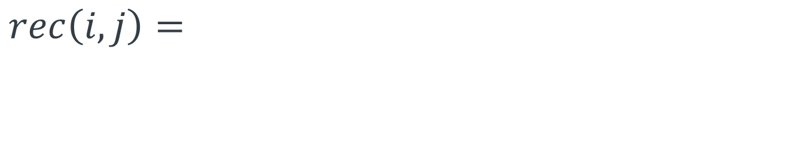

$$0$$
$$if i=n \text{or} j<0 \text{or} j=m$$
$$rec\left(i,j\right)=$$
$$otherwise$$
$$rec\left(i,j\right)=mine\left[i\right]\left[j\right]+max⁡(rec\left(i+1,j−1\right), \\ rec\left(i+1,j\right) \\ rec(i+1,j+1)$$

Slide 9

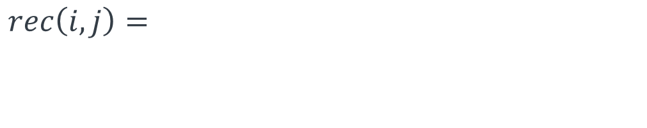


def rec(mine, i, j): n, m = len(mine), len(mine[0]) if i == n or j < 0 or j == m: return 0 else: return mine[i][j] + max(rec(mine, i+1, j-1),
rec(mine, i+1, j),
rec(mine, i+1, j+1))
$$0$$
$$if i=n \text{or} j<0 \text{or} j=m$$
$$rec\left(i,j\right)=$$
$$otherwise$$
$$rec\left(i,j\right)=mine\left[i\right]\left[j\right]+max⁡(rec\left(i+1,j−1\right), \\ rec\left(i+1,j\right) \\ rec(i+1,j+1)$$

Slide 10
3
2
12
15
10
6
19
7
11
17
8
5
12
32
21
3
20
2
9
7

Slide 11
3
2
12
15
10
6
19
7
11
17
8
5
12
32
21
3
20
2
9
7
def gold(mine): max_gold = 0 for i in range(len(mine[0])): max_gold = max(max_gold, rec(mine, 0, i)) return max_gold

Slide 12
def rec(mine, i, j): n, m = len(mine), len(mine[0]) if i == n or j < 0 or j == m: return 0 else: return mine[i][j] + max(rec(mine, i+1, j-1),
rec(mine, i+1, j),
rec(mine, i+1, j+1))

Slide 13
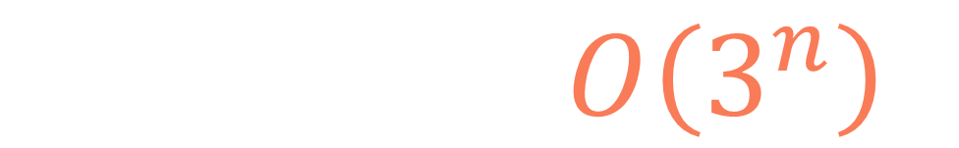
def rec(mine, i, j): n, m = len(mine), len(mine[0]) if i == n or j < 0 or j == m: return 0 else: return mine[i][j] + max(rec(mine, i+1, j-1),
rec(mine, i+1, j),
rec(mine, i+1, j+1))
number of subproblems: 3
height of the recursion tree: n
$$T\left(n,m\right)=O\left(3^{n}\right)$$

Slide 14

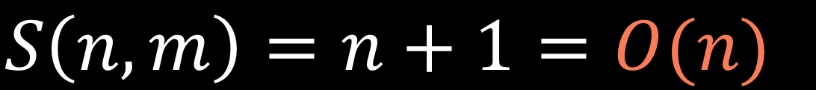
rec(n,0)
.
.
.
$$S\left(n,m\right)=n+1=O(n)$$
rec(2,0)
$$n+1$$
rec(1,0)
rec(0,0)

Slide 15
def gold(mine): max_gold = 0 for i in range(len(mine[0])): max_gold = max(max_gold, rec(mine, 0, i)) return max_gold
$$m$$
$$O(3^{n})$$
$$T_{2}\left(n,m\right)=m∗T\left(n,m\right)=m∗O\left(3^{n}\right)=O(m∗3^{n})$$

Slide 16
def gold(mine): max_gold = 0 for i in range(len(mine[0])): max_gold = max(max_gold, rec(mine, 0, i)) return max_gold
$$O(n)$$
$$S_{2}\left(n,m\right)=S(n,m)=O(n)$$

Slide 17
input:
mine = [ [3, 2, 12, 15, 10], [6, 19, 7, 11, 17], [8, 5, 12, 32, 21], [3, 20, 2, 9, 7] ]
gold(mine)
rec(0,0)
rec(0,1)
rec(0,2)
rec(0,3)
rec(0,4)
rec(1,-1)
rec(1,0)
rec(1,1)
rec(1,2)
rec(1,3)
rec(1,4)
rec(1,5)
rec(2,-1)
rec(2,0)
rec(2,1)
rec(2,2)
rec(2,3)
rec(2,4)
rec(2,5)
rec(3,-1)
rec(3,0)
rec(3,1)
rec(3,2)
rec(3,3)
rec(3,4)
rec(3,5)
rec(4,-1)
rec(4,0)
rec(4,1)
rec(4,2)
rec(4,3)
rec(4,4)
rec(4,5)

Slide 18
input:
mine = [ [3, 2, 12, 15, 10], [6, 19, 7, 11, 17], [8, 5, 12, 32, 21], [3, 20, 2, 9, 7] ]
gold(mine)
rec(0,0)
rec(0,1)
rec(0,2)
rec(0,3)
rec(0,4)
rec(1,-1)
rec(1,0)
rec(1,1)
rec(1,2)
rec(1,3)
rec(1,4)
rec(1,5)
rec(2,-1)
rec(2,0)
rec(2,1)
rec(2,2)
rec(2,3)
rec(2,4)
rec(2,5)
rec(3,-1)
rec(3,0)
rec(3,1)
rec(3,2)
rec(3,3)
rec(3,4)
rec(3,5)
rec(4,-1)
rec(4,0)
rec(4,1)
rec(4,2)
rec(4,3)
rec(4,4)
rec(4,5)

Slide 19
1
def rec(mine, i, j, lookup): n, m = len(mine), len(mine[0]) if (i, j) in lookup: return lookup[(i, j)] if i == n or j < 0 or j == m: return 0 else: lookup[(i, j)] = mine[i][j] + max(rec(mine, i+1, j-1, lookup),
rec(mine, i+1, j, lookup),
rec(mine, i+1, j+1, lookup)) return lookup[(i, j)] def gold(mine): max_gold = 0 lookup = {} for i in range(len(mine[0])): max_gold = max(max_gold, rec(mine, 0, i, lookup)) return max_gold
3
4
2

Slide 20


$$i∈\left\{0, 1, …, n−1\right\} \\ j∈\left\{0, 1, …, m−1\right\} \\ \left(i, j\right)∈\left\{\left(0, 0\right), \left(0,1\right), …, \left(n−1, m−1\right)\right\}$$
$$nm$$
$$T\left(n,m\right)=nm∗O\left(1\right)=O(nm)$$

Slide 21
3
2
12
15
10
solved by the 1st call
6
19
7
11
17
solved by the 2nd call
solved by the 3rd call
8
5
12
32
21
solved by the 4th call
solved by the 5th call
3
20
2
9
7

Slide 22
$$S(n,m)=O\left(n\right)+O\left(nm\right)=O(nm)$$
call stack size
lookup table size

Slide 23



$$i∈\left\{0, 1, …, n−1\right\}$$
$$j∈\left\{0, 1, …, m−1\right\}$$
$$n$$
$$m$$

Slide 24



$$i∈\left\{0, 1, …, n−1\right\}$$
$$j∈\left\{0, 1, …, m−1\right\}$$
$$m$$
dp
$$n$$
$$m$$
$$n$$

Slide 25


$$m$$
dp
dp[i][j] represents the maximum amount of gold that we can get by stopping at the cell (i, j)
$$n$$

Slide 26
3
2
12
15
10
6
19
7
11
17
8
5
12
32
21
3
20
2
9
7

Slide 27
3
2
12
15
10
6
19
7
11
17
8
5
12
32
21
3
20
2
9
7
n-1
return max(dp[n-1])

Slide 28
input:
mine = [ [3, 2, 12, 15, 10], [6, 19, 7, 11, 17], [8, 5, 12, 32, 21], [3, 20, 2, 9, 7] ]
dp
mine
3
2
12
15
10
6
19
7
11
17
8
5
12
32
21
3
20
2
9
7

Slide 29
input:
mine = [ [3, 2, 12, 15, 10], [6, 19, 7, 11, 17], [8, 5, 12, 32, 21], [3, 20, 2, 9, 7] ]
dp
3
mine
3
2
12
15
10
6
19
7
11
17
8
5
12
32
21
3
20
2
9
7

Slide 30
input:
mine = [ [3, 2, 12, 15, 10], [6, 19, 7, 11, 17], [8, 5, 12, 32, 21], [3, 20, 2, 9, 7] ]
dp
3
2
mine
3
2
12
15
10
6
19
7
11
17
8
5
12
32
21
3
20
2
9
7

Slide 31
input:
mine = [ [3, 2, 12, 15, 10], [6, 19, 7, 11, 17], [8, 5, 12, 32, 21], [3, 20, 2, 9, 7] ]
dp
3
2
12
mine
3
2
12
15
10
6
19
7
11
17
8
5
12
32
21
3
20
2
9
7

Slide 32
input:
mine = [ [3, 2, 12, 15, 10], [6, 19, 7, 11, 17], [8, 5, 12, 32, 21], [3, 20, 2, 9, 7] ]
dp
3
2
12
15
mine
3
2
12
15
10
6
19
7
11
17
8
5
12
32
21
3
20
2
9
7

Slide 33
input:
mine = [ [3, 2, 12, 15, 10], [6, 19, 7, 11, 17], [8, 5, 12, 32, 21], [3, 20, 2, 9, 7] ]
dp
3
2
12
15
10
mine
3
2
12
15
10
6
19
7
11
17
8
5
12
32
21
3
20
2
9
7

Slide 34
j-1
j
j+1
i-1
i
$$rec\left(i,j\right)=$$
$$rec\left(i,j\right)=mine\left[i\right]\left[j\right]+max⁡(rec\left(i+1,j−1\right), \\ rec\left(i+1,j\right) \\ rec(i+1,j+1)$$

Slide 35
input:
mine = [ [3, 2, 12, 15, 10], [6, 19, 7, 11, 17], [8, 5, 12, 32, 21], [3, 20, 2, 9, 7] ]
dp
3
2
12
15
10
mine
3
2
12
15
10
6
19
7
11
17
8
5
12
32
21
3
20
2
9
7

Slide 36
input:
mine = [ [3, 2, 12, 15, 10], [6, 19, 7, 11, 17], [8, 5, 12, 32, 21], [3, 20, 2, 9, 7] ]
dp
3
2
12
15
10
9
mine
3
2
12
15
10
6
19
7
11
17
8
5
12
32
21
3
20
2
9
7

Slide 37
input:
mine = [ [3, 2, 12, 15, 10], [6, 19, 7, 11, 17], [8, 5, 12, 32, 21], [3, 20, 2, 9, 7] ]
dp
3
2
12
15
10
9
mine
3
2
12
15
10
6
19
7
11
17
8
5
12
32
21
3
20
2
9
7

Slide 38
input:
mine = [ [3, 2, 12, 15, 10], [6, 19, 7, 11, 17], [8, 5, 12, 32, 21], [3, 20, 2, 9, 7] ]
dp
3
2
12
15
10
9
31
mine
3
2
12
15
10
6
19
7
11
17
8
5
12
32
21
3
20
2
9
7

Slide 39
input:
mine = [ [3, 2, 12, 15, 10], [6, 19, 7, 11, 17], [8, 5, 12, 32, 21], [3, 20, 2, 9, 7] ]
dp
3
2
12
15
10
9
31
mine
3
2
12
15
10
6
19
7
11
17
8
5
12
32
21
3
20
2
9
7

Slide 40
input:
mine = [ [3, 2, 12, 15, 10], [6, 19, 7, 11, 17], [8, 5, 12, 32, 21], [3, 20, 2, 9, 7] ]
dp
3
2
12
15
10
9
31
22
mine
3
2
12
15
10
6
19
7
11
17
8
5
12
32
21
3
20
2
9
7

Slide 41
input:
mine = [ [3, 2, 12, 15, 10], [6, 19, 7, 11, 17], [8, 5, 12, 32, 21], [3, 20, 2, 9, 7] ]
dp
3
2
12
15
10
9
31
22
mine
3
2
12
15
10
6
19
7
11
17
8
5
12
32
21
3
20
2
9
7

Slide 42
input:
mine = [ [3, 2, 12, 15, 10], [6, 19, 7, 11, 17], [8, 5, 12, 32, 21], [3, 20, 2, 9, 7] ]
dp
3
2
12
15
10
9
31
22
26
mine
3
2
12
15
10
6
19
7
11
17
8
5
12
32
21
3
20
2
9
7

Slide 43
input:
mine = [ [3, 2, 12, 15, 10], [6, 19, 7, 11, 17], [8, 5, 12, 32, 21], [3, 20, 2, 9, 7] ]
dp
3
2
12
15
10
9
31
22
26
mine
3
2
12
15
10
6
19
7
11
17
8
5
12
32
21
3
20
2
9
7

Slide 44
input:
mine = [ [3, 2, 12, 15, 10], [6, 19, 7, 11, 17], [8, 5, 12, 32, 21], [3, 20, 2, 9, 7] ]
dp
3
2
12
15
10
9
31
22
26
32
mine
3
2
12
15
10
6
19
7
11
17
8
5
12
32
21
3
20
2
9
7

Slide 45
input:
mine = [ [3, 2, 12, 15, 10], [6, 19, 7, 11, 17], [8, 5, 12, 32, 21], [3, 20, 2, 9, 7] ]
dp
3
2
12
15
10
9
31
22
26
32
mine
3
2
12
15
10
6
19
7
11
17
8
5
12
32
21
3
20
2
9
7

Slide 46
input:
mine = [ [3, 2, 12, 15, 10], [6, 19, 7, 11, 17], [8, 5, 12, 32, 21], [3, 20, 2, 9, 7] ]
dp
3
2
12
15
10
9
31
22
26
32
mine
3
2
12
15
10
39
6
19
7
11
17
8
5
12
32
21
3
20
2
9
7

Slide 47
input:
mine = [ [3, 2, 12, 15, 10], [6, 19, 7, 11, 17], [8, 5, 12, 32, 21], [3, 20, 2, 9, 7] ]
dp
3
2
12
15
10
9
31
22
26
32
mine
3
2
12
15
10
39
6
19
7
11
17
8
5
12
32
21
3
20
2
9
7

Slide 48
input:
mine = [ [3, 2, 12, 15, 10], [6, 19, 7, 11, 17], [8, 5, 12, 32, 21], [3, 20, 2, 9, 7] ]
dp
3
2
12
15
10
9
31
22
26
32
mine
3
2
12
15
10
39
36
6
19
7
11
17
8
5
12
32
21
3
20
2
9
7

Slide 49
input:
mine = [ [3, 2, 12, 15, 10], [6, 19, 7, 11, 17], [8, 5, 12, 32, 21], [3, 20, 2, 9, 7] ]
dp
3
2
12
15
10
9
31
22
26
32
mine
3
2
12
15
10
39
36
6
19
7
11
17
8
5
12
32
21
3
20
2
9
7

Slide 50
input:
mine = [ [3, 2, 12, 15, 10], [6, 19, 7, 11, 17], [8, 5, 12, 32, 21], [3, 20, 2, 9, 7] ]
dp
3
2
12
15
10
9
31
22
26
32
mine
3
2
12
15
10
39
36
43
6
19
7
11
17
8
5
12
32
21
3
20
2
9
7

Slide 51
input:
mine = [ [3, 2, 12, 15, 10], [6, 19, 7, 11, 17], [8, 5, 12, 32, 21], [3, 20, 2, 9, 7] ]
dp
3
2
12
15
10
9
31
22
26
32
mine
3
2
12
15
10
39
36
43
6
19
7
11
17
8
5
12
32
21
3
20
2
9
7

Slide 52
input:
mine = [ [3, 2, 12, 15, 10], [6, 19, 7, 11, 17], [8, 5, 12, 32, 21], [3, 20, 2, 9, 7] ]
dp
3
2
12
15
10
9
31
22
26
32
mine
3
2
12
15
10
39
36
43
64
6
19
7
11
17
8
5
12
32
21
3
20
2
9
7

Slide 53
input:
mine = [ [3, 2, 12, 15, 10], [6, 19, 7, 11, 17], [8, 5, 12, 32, 21], [3, 20, 2, 9, 7] ]
dp
3
2
12
15
10
9
31
22
26
32
mine
3
2
12
15
10
39
36
43
64
6
19
7
11
17
8
5
12
32
21
3
20
2
9
7

Slide 54
input:
mine = [ [3, 2, 12, 15, 10], [6, 19, 7, 11, 17], [8, 5, 12, 32, 21], [3, 20, 2, 9, 7] ]
dp
3
2
12
15
10
9
31
22
26
32
mine
3
2
12
15
10
39
36
43
64
53
6
19
7
11
17
8
5
12
32
21
3
20
2
9
7

Slide 55
input:
mine = [ [3, 2, 12, 15, 10], [6, 19, 7, 11, 17], [8, 5, 12, 32, 21], [3, 20, 2, 9, 7] ]
dp
3
2
12
15
10
9
31
22
26
32
mine
3
2
12
15
10
39
36
43
64
53
6
19
7
11
17
8
5
12
32
21
3
20
2
9
7

Slide 56
input:
mine = [ [3, 2, 12, 15, 10], [6, 19, 7, 11, 17], [8, 5, 12, 32, 21], [3, 20, 2, 9, 7] ]
dp
3
2
12
15
10
9
31
22
26
32
mine
3
2
12
15
10
39
36
43
64
53
6
19
7
11
17
42
8
5
12
32
21
3
20
2
9
7

Slide 57
input:
mine = [ [3, 2, 12, 15, 10], [6, 19, 7, 11, 17], [8, 5, 12, 32, 21], [3, 20, 2, 9, 7] ]
dp
3
2
12
15
10
9
31
22
26
32
mine
3
2
12
15
10
39
36
43
64
53
6
19
7
11
17
42
8
5
12
32
21
3
20
2
9
7

Slide 58
input:
mine = [ [3, 2, 12, 15, 10], [6, 19, 7, 11, 17], [8, 5, 12, 32, 21], [3, 20, 2, 9, 7] ]
dp
3
2
12
15
10
9
31
22
26
32
mine
3
2
12
15
10
39
36
43
64
53
6
19
7
11
17
42
63
8
5
12
32
21
3
20
2
9
7

Slide 59
input:
mine = [ [3, 2, 12, 15, 10], [6, 19, 7, 11, 17], [8, 5, 12, 32, 21], [3, 20, 2, 9, 7] ]
dp
3
2
12
15
10
9
31
22
26
32
mine
3
2
12
15
10
39
36
43
64
53
6
19
7
11
17
42
63
8
5
12
32
21
3
20
2
9
7

Slide 60
input:
mine = [ [3, 2, 12, 15, 10], [6, 19, 7, 11, 17], [8, 5, 12, 32, 21], [3, 20, 2, 9, 7] ]
dp
3
2
12
15
10
9
31
22
26
32
mine
3
2
12
15
10
39
36
43
64
53
6
19
7
11
17
42
63
66
8
5
12
32
21
3
20
2
9
7

Slide 61
input:
mine = [ [3, 2, 12, 15, 10], [6, 19, 7, 11, 17], [8, 5, 12, 32, 21], [3, 20, 2, 9, 7] ]
dp
3
2
12
15
10
9
31
22
26
32
mine
3
2
12
15
10
39
36
43
64
53
6
19
7
11
17
42
63
66
8
5
12
32
21
3
20
2
9
7

Slide 62
input:
mine = [ [3, 2, 12, 15, 10], [6, 19, 7, 11, 17], [8, 5, 12, 32, 21], [3, 20, 2, 9, 7] ]
dp
3
2
12
15
10
9
31
22
26
32
mine
3
2
12
15
10
39
36
43
64
53
6
19
7
11
17
42
63
66
73
8
5
12
32
21
3
20
2
9
7

Slide 63
input:
mine = [ [3, 2, 12, 15, 10], [6, 19, 7, 11, 17], [8, 5, 12, 32, 21], [3, 20, 2, 9, 7] ]
dp
3
2
12
15
10
9
31
22
26
32
mine
3
2
12
15
10
39
36
43
64
53
6
19
7
11
17
42
63
66
73
8
5
12
32
21
3
20
2
9
7

Slide 64
input:
mine = [ [3, 2, 12, 15, 10], [6, 19, 7, 11, 17], [8, 5, 12, 32, 21], [3, 20, 2, 9, 7] ]
dp
3
2
12
15
10
9
31
22
26
32
mine
3
2
12
15
10
39
36
43
64
53
6
19
7
11
17
42
63
66
73
71
8
5
12
32
21
3
20
2
9
7

Slide 65
input:
mine = [ [3, 2, 12, 15, 10], [6, 19, 7, 11, 17], [8, 5, 12, 32, 21], [3, 20, 2, 9, 7] ]
dp
3
2
12
15
10
9
31
22
26
32
mine
3
2
12
15
10
39
36
43
64
53
6
19
7
11
17
42
63
66
73
71
8
5
12
32
21
3
20
2
9
7

Slide 66
input:
mine = [ [3, 2, 12, 15, 10], [6, 19, 7, 11, 17], [8, 5, 12, 32, 21], [3, 20, 2, 9, 7] ]
dp
3
2
12
15
10
9
31
22
26
32
mine
3
2
12
15
10
39
36
43
64
53
6
19
7
11
17
42
63
66
73
71
8
5
12
32
21
3
20
2
9
7

Slide 67
input:
mine = [ [3, 2, 12, 15, 10], [6, 19, 7, 11, 17], [8, 5, 12, 32, 21], [3, 20, 2, 9, 7] ]
dp
3
2
12
15
10
9
31
22
26
32
mine
3
2
12
15
10
39
36
43
64
53
6
19
7
11
17
42
63
66
73
71
8
5
12
32
21
3
20
2
9
7

Slide 68
def gold(mine): n, m = len(mine), len(mine[0]) dp = [[0]*m for i in range(n)] for j in range(m): dp[0][j] = mine[0][j] for i in range(1, n): for j in range(m): top_left = dp[i-1][j-1] if (j-1) >= 0 else 0 top = dp[i-1][j] top_right = dp[i-1][j+1] if (j+1) < m else 0 dp[i][j] = mine[i][j] + max(top_left, top, top_right) return max(dp[n-1])

Slide 69
def gold(mine): n, m = len(mine), len(mine[0]) dp = [[0]*m for i in range(n)] for j in range(m): dp[0][j] = mine[0][j] for i in range(1, n): for j in range(m): top_left = dp[i-1][j-1] if (j-1) >= 0 else 0 top = dp[i-1][j] top_right = dp[i-1][j+1] if (j+1) < m else 0 dp[i][j] = mine[i][j] + max(top_left, top, top_right) return max(dp[n-1])

Slide 70
def gold(mine): n, m = len(mine), len(mine[0]) dp = [[0]*m for i in range(n)] for j in range(m): dp[0][j] = mine[0][j] for i in range(1, n): for j in range(m): top_left = dp[i-1][j-1] if (j-1) >= 0 else 0 top = dp[i-1][j] top_right = dp[i-1][j+1] if (j+1) < m else 0 dp[i][j] = mine[i][j] + max(top_left, top, top_right) return max(dp[n-1])

Slide 71
def gold(mine): n, m = len(mine), len(mine[0]) dp = [[0]*m for i in range(n)] for j in range(m): dp[0][j] = mine[0][j] for i in range(1, n): for j in range(m): top_left = dp[i-1][j-1] if (j-1) >= 0 else 0 top = dp[i-1][j] top_right = dp[i-1][j+1] if (j+1) < m else 0 dp[i][j] = mine[i][j] + max(top_left, top, top_right) return max(dp[n-1])

Slide 72
def gold(mine): n, m = len(mine), len(mine[0]) dp = [[0]*m for i in range(n)] for j in range(m): dp[0][j] = mine[0][j] for i in range(1, n): for j in range(m): top_left = dp[i-1][j-1] if (j-1) >= 0 else 0 top = dp[i-1][j] top_right = dp[i-1][j+1] if (j+1) < m else 0 dp[i][j] = mine[i][j] + max(top_left, top, top_right) return max(dp[n-1])

Slide 73
def gold(mine): n, m = len(mine), len(mine[0]) dp = [[0]*m for i in range(n)] for j in range(m): dp[0][j] = mine[0][j] for i in range(1, n): for j in range(m): top_left = dp[i-1][j-1] if (j-1) >= 0 else 0 top = dp[i-1][j] top_right = dp[i-1][j+1] if (j+1) < m else 0 dp[i][j] = mine[i][j] + max(top_left, top, top_right) return max(dp[n-1])

Slide 74
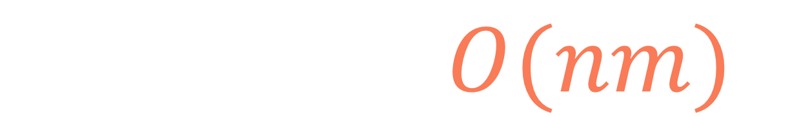
def gold(mine): n, m = len(mine), len(mine[0]) dp = [[0]*m for i in range(n)] for j in range(m): dp[0][j] = mine[0][j] for i in range(1, n): for j in range(m): top_left = dp[i-1][j-1] if (j-1) >= 0 else 0 top = dp[i-1][j] top_right = dp[i-1][j+1] if (j+1) < m else 0 dp[i][j] = mine[i][j] + max(top_left, top, top_right) return max(dp[n-1])
$$T\left(n,m\right)=O(nm)$$

Slide 75
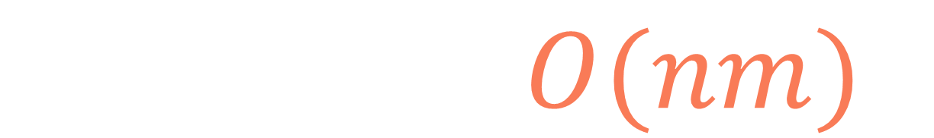
def gold(mine): n, m = len(mine), len(mine[0]) dp = [[0]*m for i in range(n)] for j in range(m): dp[0][j] = mine[0][j] for i in range(1, n): for j in range(m): top_left = dp[i-1][j-1] if (j-1) >= 0 else 0 top = dp[i-1][j] top_right = dp[i-1][j+1] if (j+1) < m else 0 dp[i][j] = mine[i][j] + max(top_left, top, top_right) return max(dp[n-1])
$$S\left(n,m\right)=O(nm)$$

Slide 76
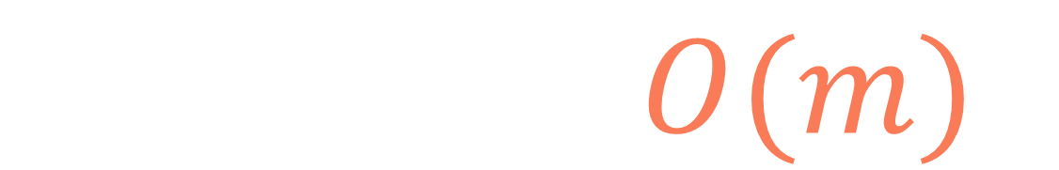
def gold(mine): n, m = len(mine), len(mine[0]) prev_dp = [0]*m dp = [0]*m for j in range(m): prev_dp[j] = mine[0][j] for i in range(1, n): for j in range(m): top_left = prev_dp[j-1] if (j-1) >= 0 else 0 top = prev_dp[j] top_right = prev_dp[j+1] if (j+1) < m else 0 dp[j] = mine[i][j] + max(top_left, top, top_right) prev_dp = dp dp = [0]*m return max(prev_dp)
$$S\left(n,m\right)=O(m)$$

Slide 77
Gold mine

